Slide 1
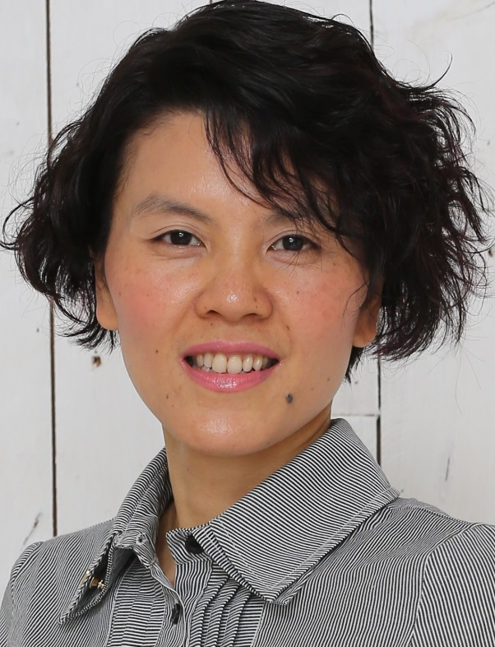

你的選擇
Your Choice
Kawae Cheung
高級顧問經理級
Director
四個佣金週期共賺取HK$138,000
HK$138,000 in 4 Commission weeks
本簡報中提到的收入等級純屬舉例說明，無意代表美安香港超連鎖™店主的一般收入，也無意表示任何超連鎖™店主皆可賺取同等收入。美安香港超連鎖™店主的成功與否，取決於其在發展事業時的努力、才能與投入程度。
The income levels mentioned in the following presentation are for illustration purposes only. They are not intended to represent the income of a typical Market Hong Kong UnFranchise ™Owner, nor are they intended to represent that any given Independent UnFranchise ™ Owner will earn income in that amount. The success of any Market Hong Kong Independent UnFranchise ™ Owner will depend upon the amount of hard work, talent, and dedication which he or she devotes to building his or her Market Hong Kong Business.

Slide 2
Your Choice
Kawae Cheung

Slide 3


We make choices in every single minute in life.

Slide 4

“One's philosophy is not best expressed in words; it is expressed in the choices one makes. In the long run, we shape our lives, and we shape ourselves. The process never ends until we die. And the choices we make are ultimately our own responsibility”
── Eleanor Roosevelt

Slide 5

Your Choice– WHY
WHY

Slide 6
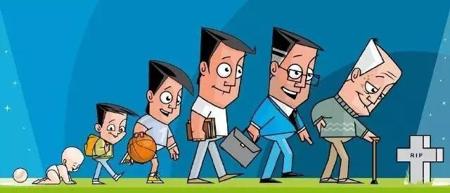
Your Choice
Die
Born

Slide 7
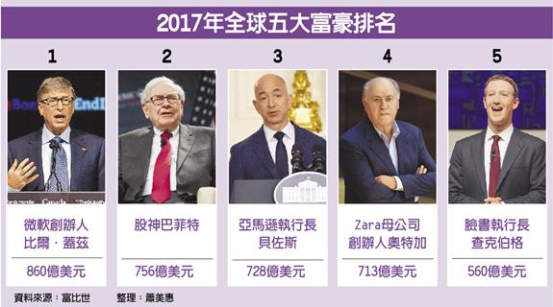
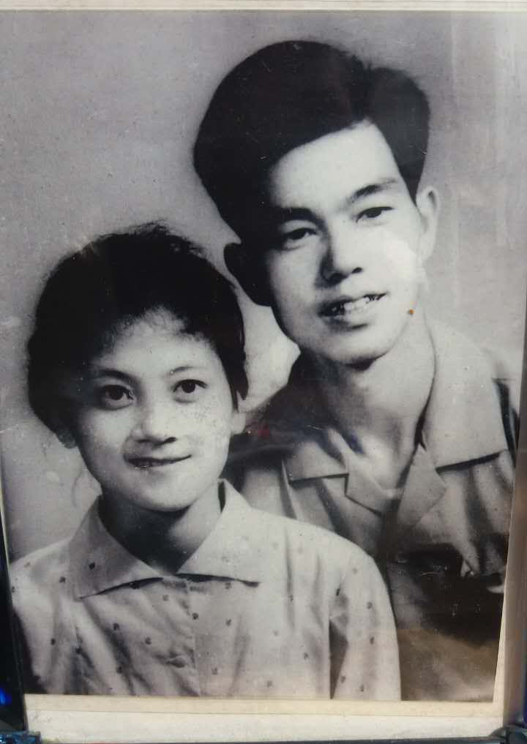
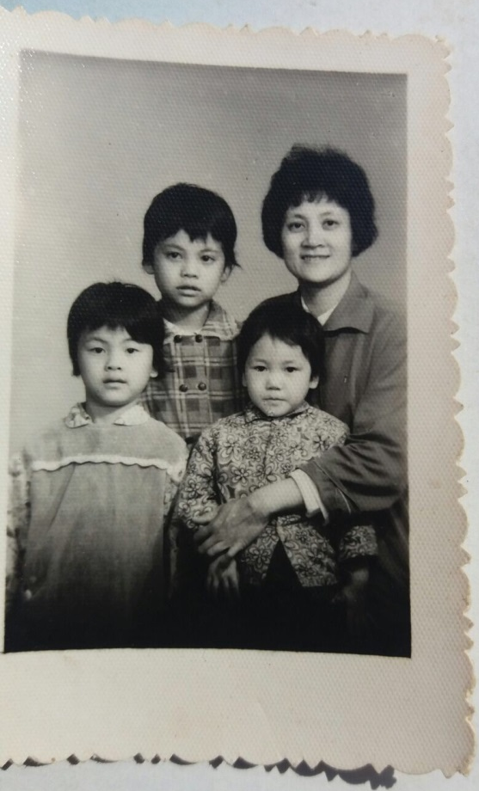
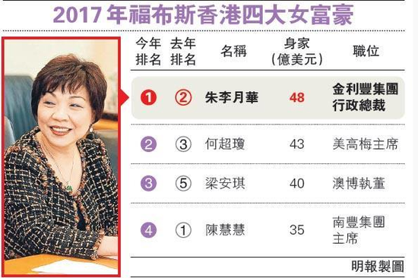
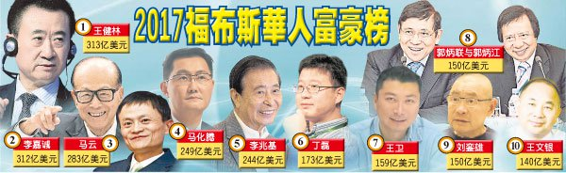
Your Choice
Parents
Children

Slide 8






Do you have choice？
study
friends
job
life
marriage

Slide 9


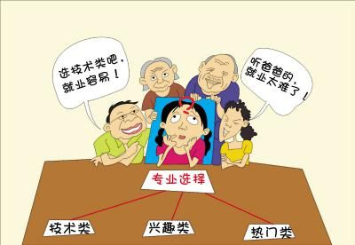
How to Choose

Slide 10

For Whom？Why？Why should I？

Slide 11

A wrong decision made in a moment of weakness
Choice is more important
than effort

Slide 12

How to Choose: By Knowleage
Income
vs
ongoing income
Understand the business nature to see the value

Slide 13

How to Choose: By Attitude
Attitude
Positive
vs
Negative
Believe
vs
Unbelieve
Take responsibility
vs
Make excuse
Career
vs
Hobby
Persistence
vs
Giving up

Slide 14

How to Choose: By Attitude
Go all out
Vs
Undisciplined
Active
vs
Passive
Face the problem vs Escape from reality
Action
Vs
Stay

Slide 15
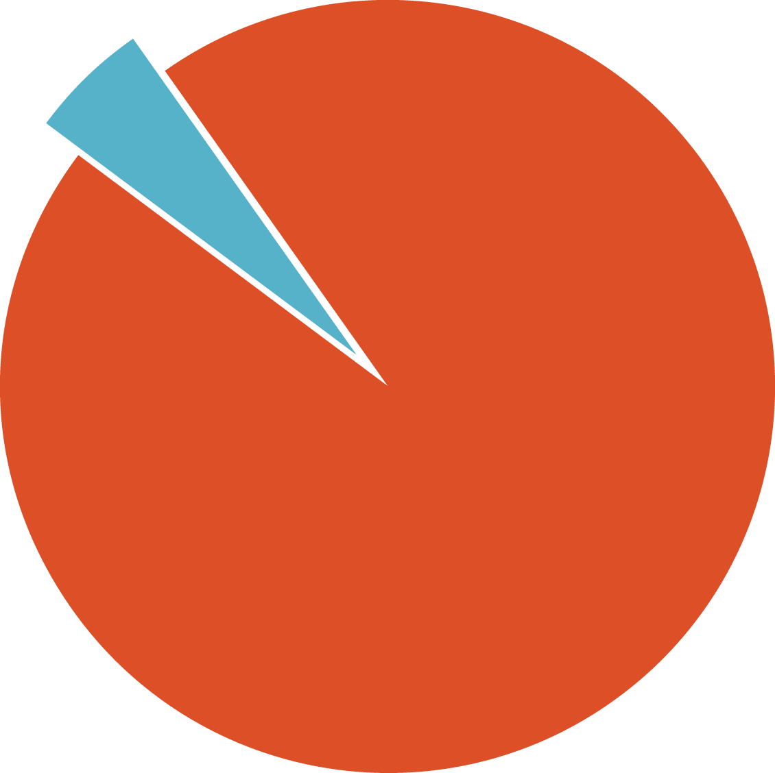

TRADITIONAL 45 YEAR PLAN
95 PERCENT OF PEOPLE SPEND UP TO 45 YEARS OF THEIR LIVES MAKING THE OTHER 5 PERCENT SUCCESSFUL
THEY WORK A PLAN FOR SOMEONE ELSE’S FINANCIAL SUCCESS – NOT THEIR OWN
5%
95%
FINANCIALLY FIT
STRUGGLING FINANCIALLY

Slide 16
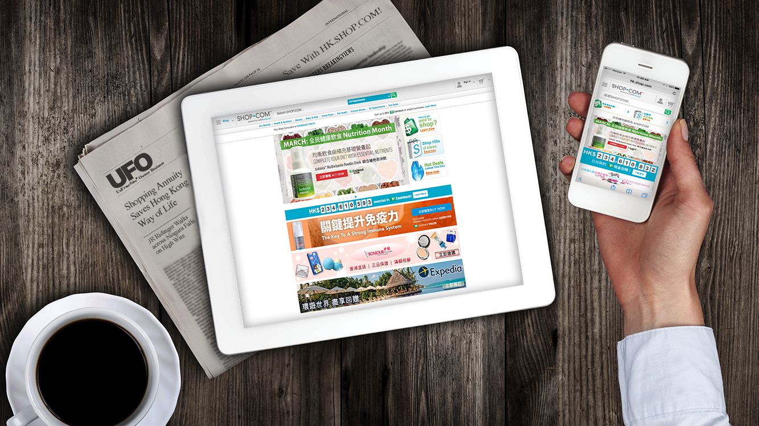
[
]
A 2-3 YEAR PLAN TO BUILD A FOUNDATION
FOR YOUR FINANCIAL FUTURE

Slide 17
This is your choice
You can keep spending and earning money for others.
OR
You can convert your spending into earning by shopping annuity.
Which WILL YOU CHOOSE?
Notes:
TRAINERS NOTES:
This is critical! Do not skip through this slide. It’s the equivalent of the the slide in the UBP which asks if they want the 45 year plan or the UnFranchise.
You can continue to spend money you are already spending the way that you’re spending it. This will continue to make money for the companies you purchase from and earn you nothing. Nothing changes! OR
You can convert your spending into earning. Continue to purchase all of the things you are going to purchase anyway and be paid on those margins from your spending as well as the spending of anyone you lead to directly or indirectly.

Slide 18

WHAT IF YOU HAD AN OPTION?

Slide 19
Your Choice, Cost, Value
Wedding anniversary, Daughters’ birthday, Mother’s Day
Events of Market America, Market Hong Kong,
Market Taiwan, Market Singapore

Slide 20

Your Choice
You can make your own decision anytime.
It’s never been easy.
It needs effort.
It needs courage.

Slide 21



Your Choice
You paid cash for your meal 10 years ago,
You pay your meal by credit card for your meal 5 years ago,
Now, you just scan your mobile for payment
What does it mean??
The future will CHANGE,
and you get the KEY

Slide 22

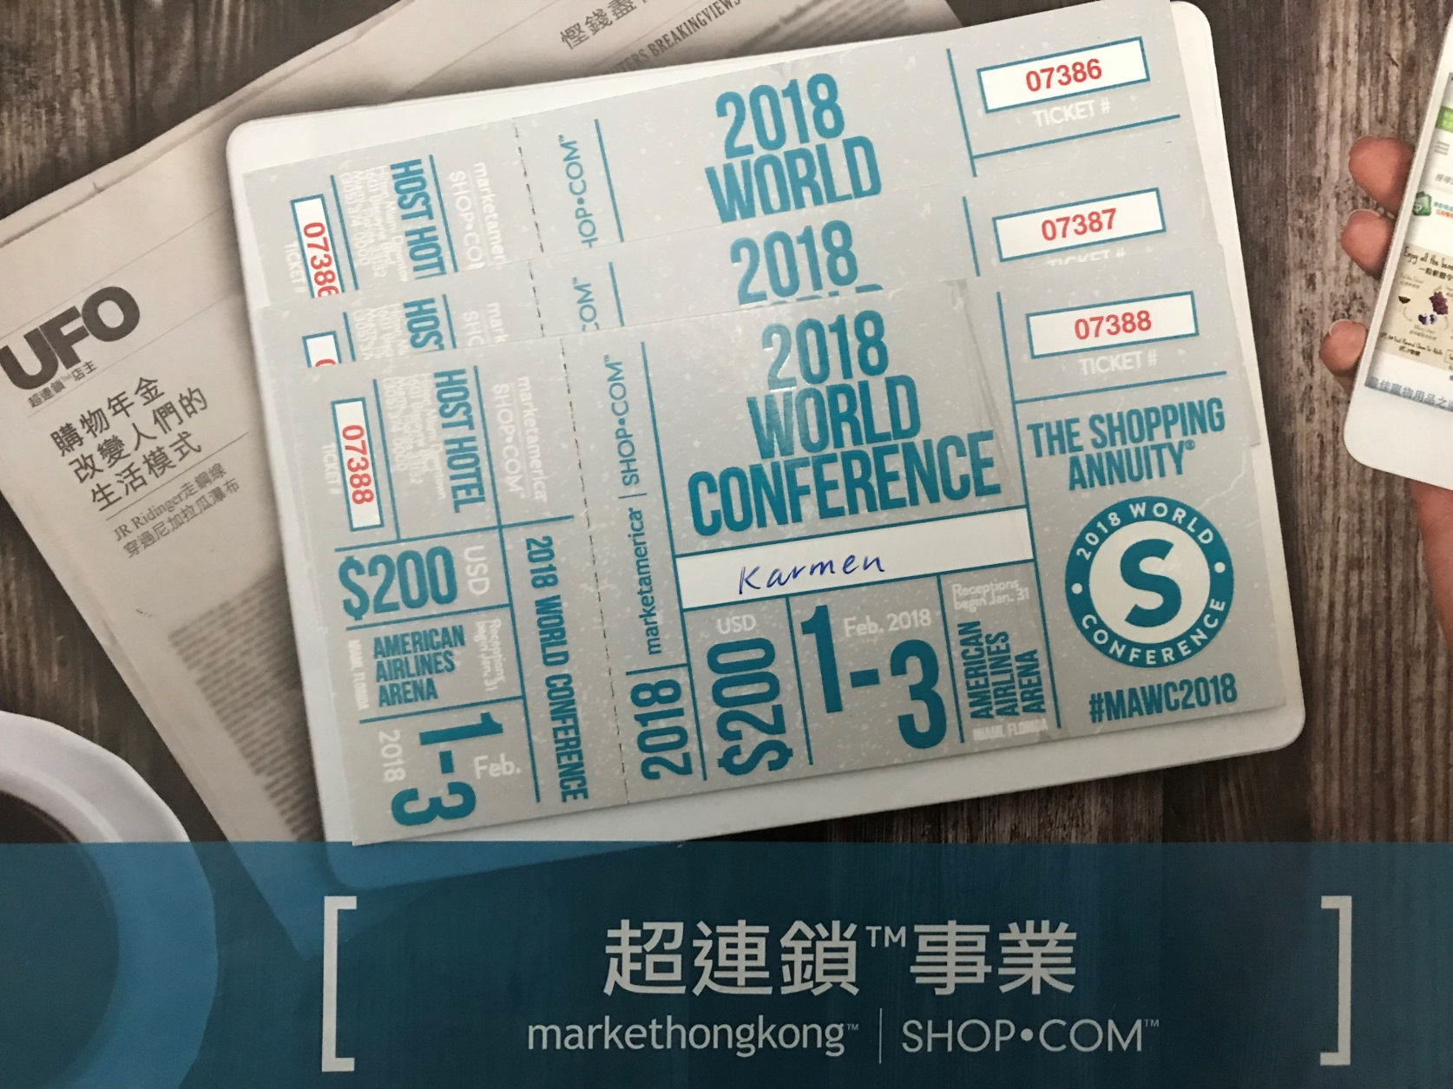


Achieve the business goal by selling TICKETS
Knowledge, Belief, Leverage
Income》HK$138,000 residual income
Health
Resolving liabilities
Financial security
Free Time
Early Retirement
Family Protection
Travelling Around the World
Personal Growth

Slide 23
Choice+ Effort = Dreams Come True
DO SOMETHING
DO NOTHING
DO ANYTHING

Slide 24

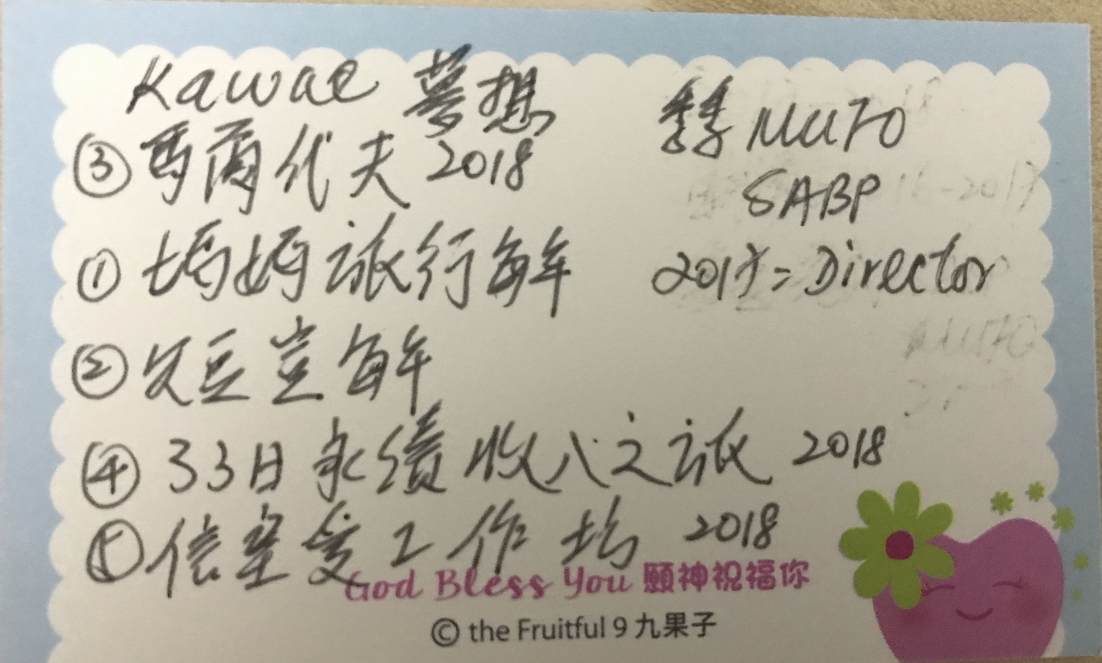
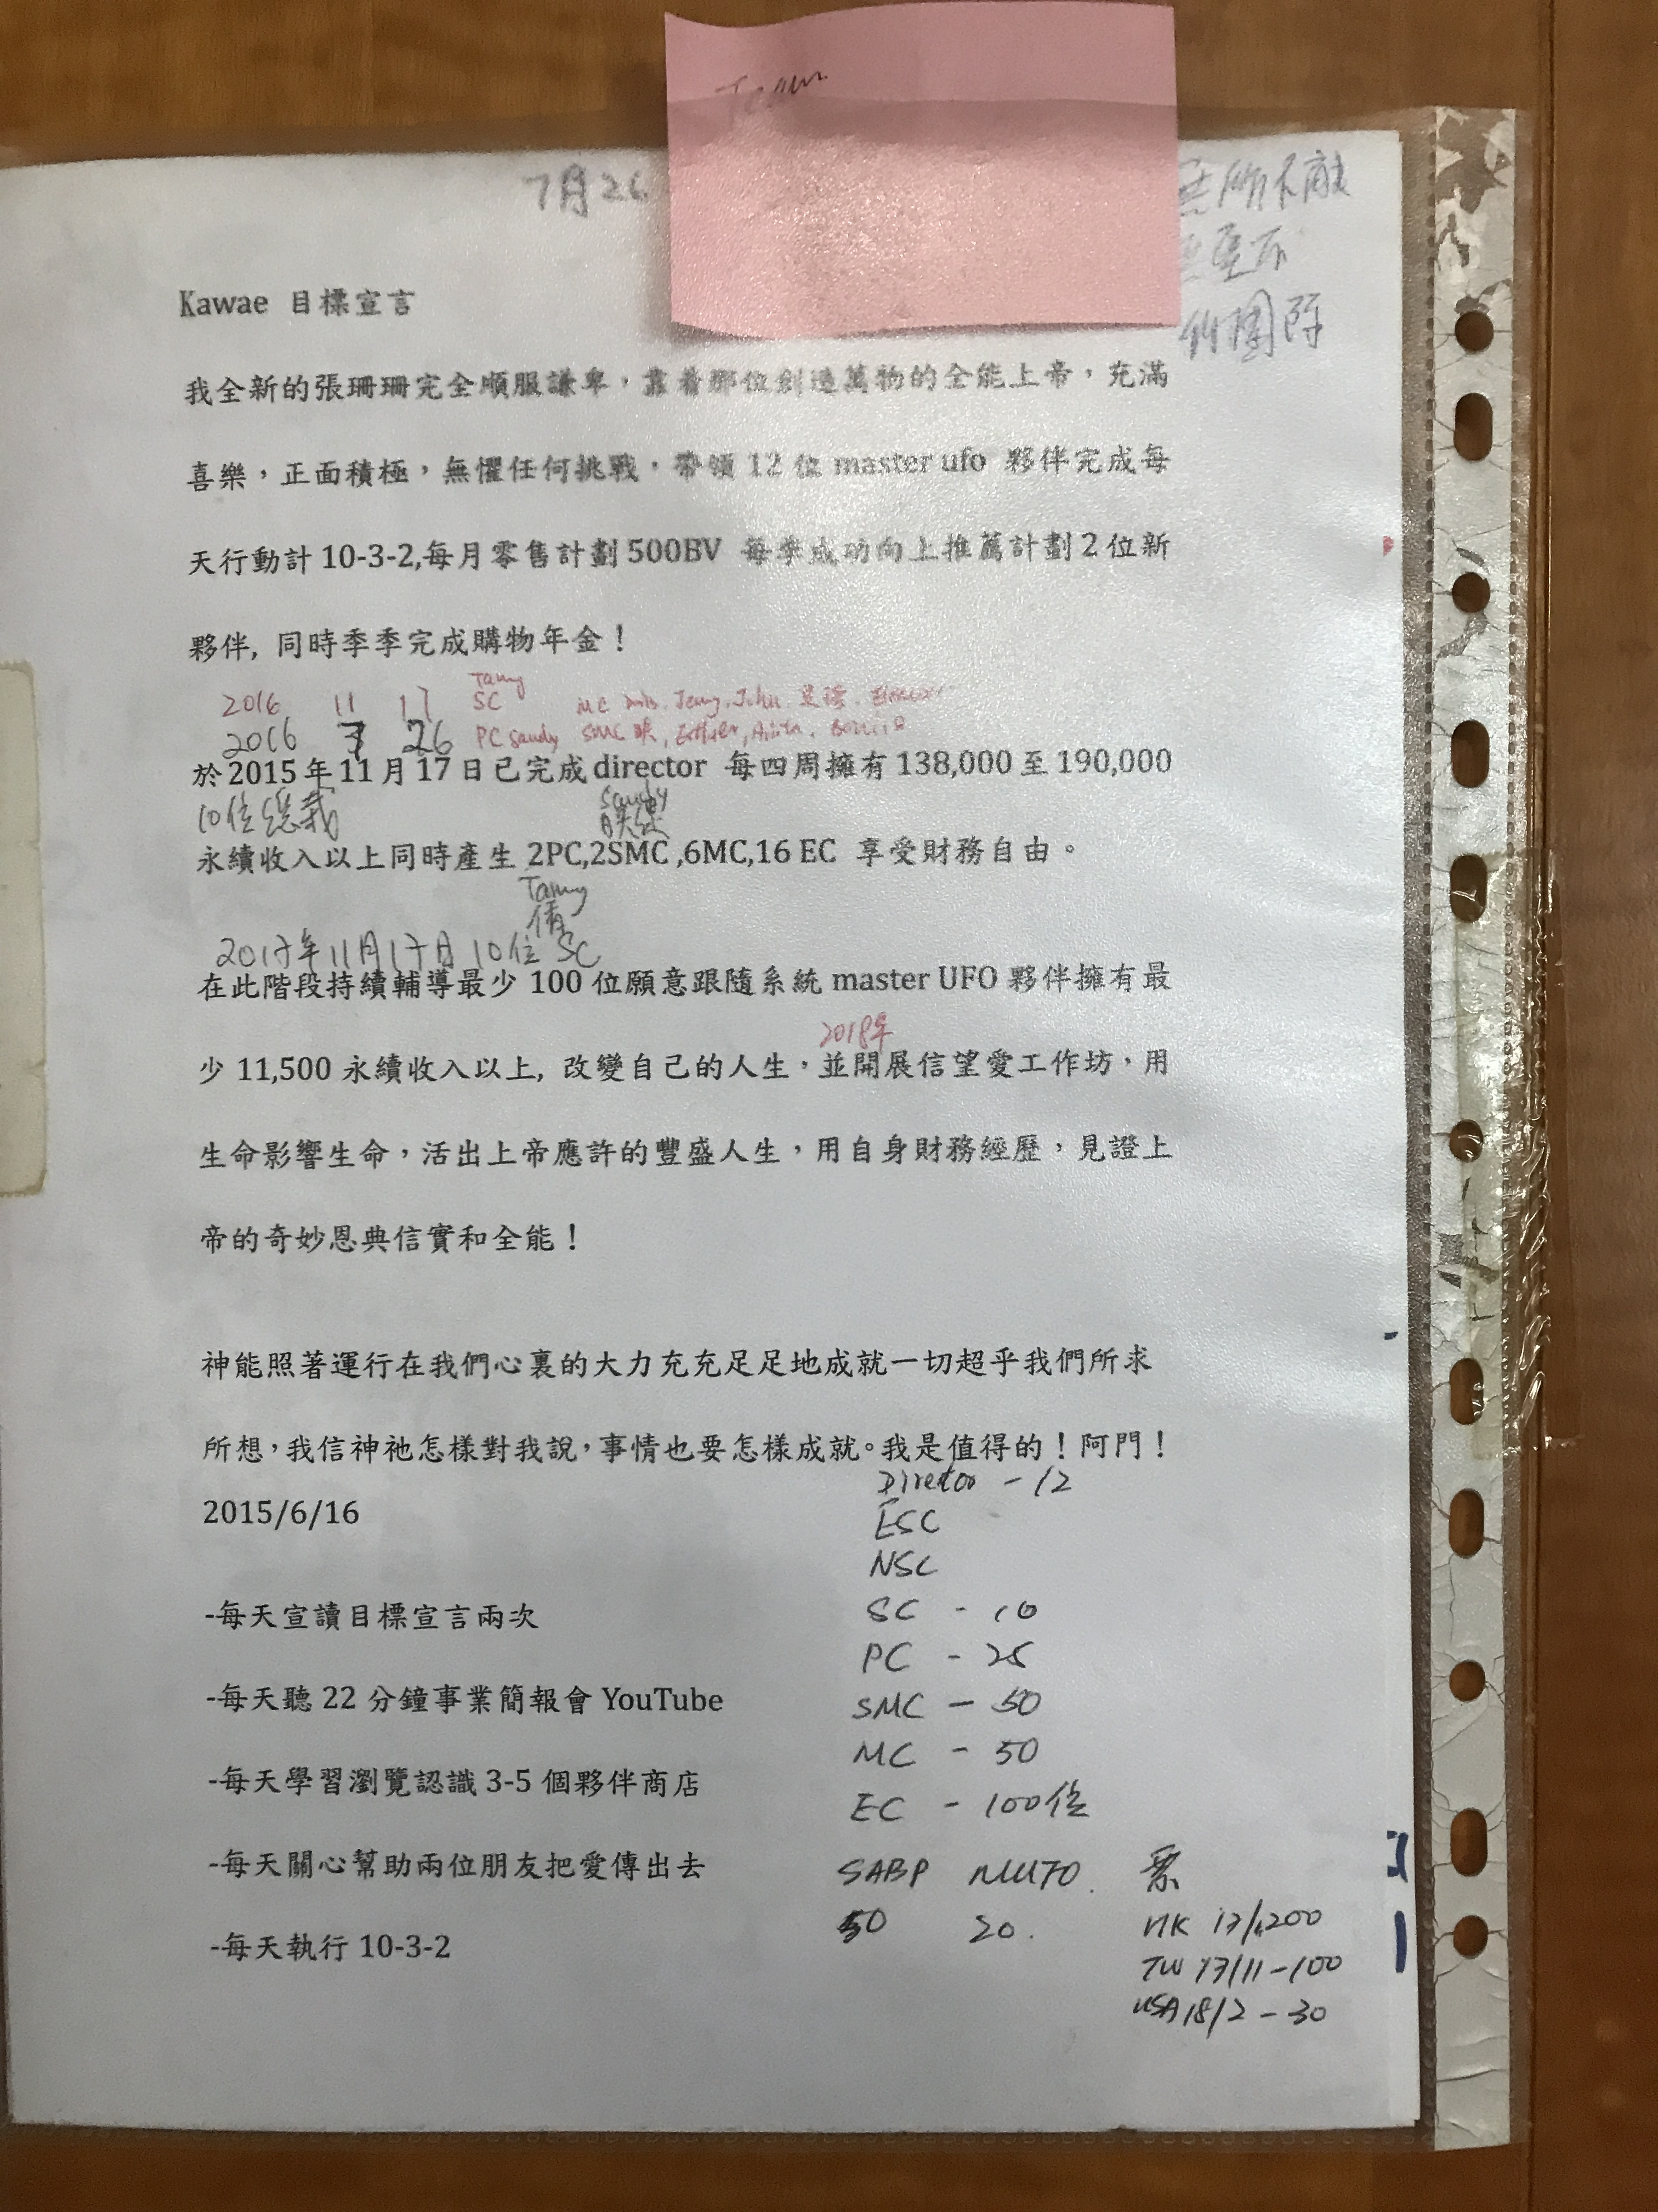
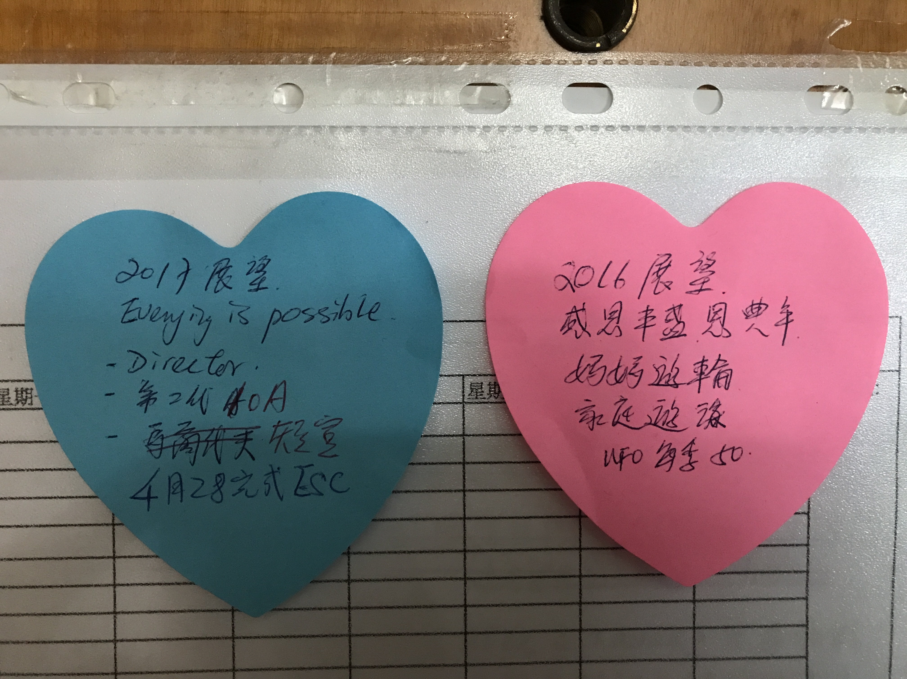


Slide 25
100 ABC --- 200 ABC

Slide 26
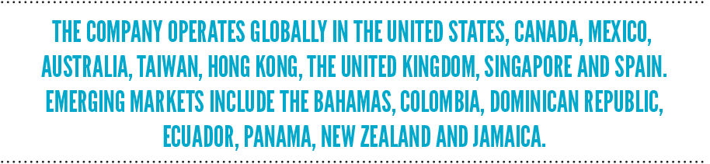


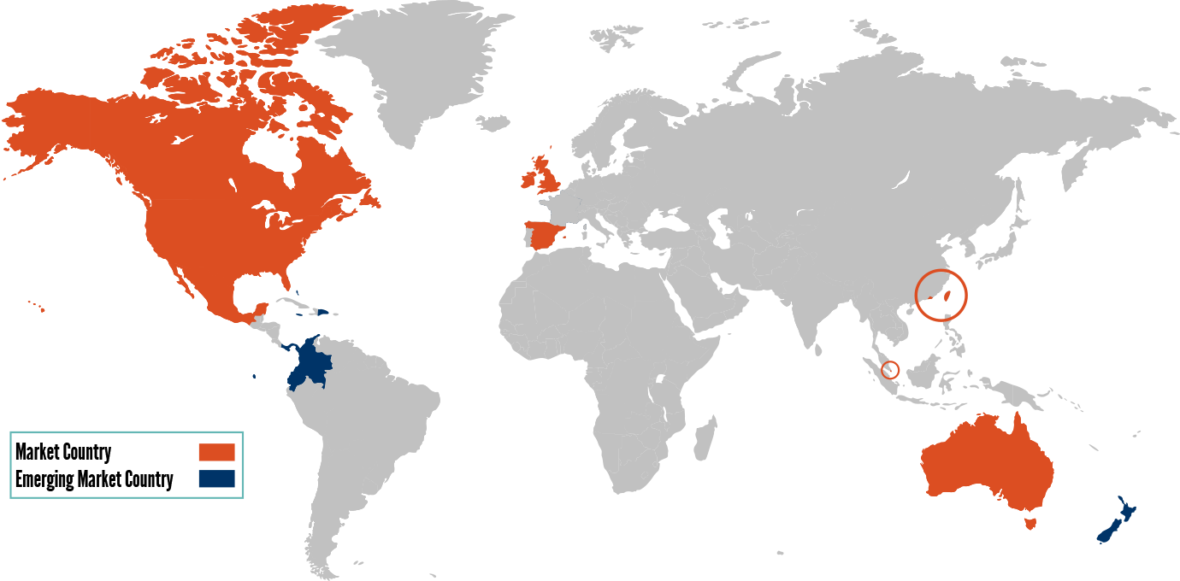
America
Europe
Asia Pacific
Journey of residual income
in 33 days
全面開發業務國家（地區）
新加入市場計劃國家
There are 10 market countries (regions) to develop the business, and seven other countries to join the emerging market plan,
In addition, Global.SHOP.COM can serve customers in more than 200 countries

Slide 27

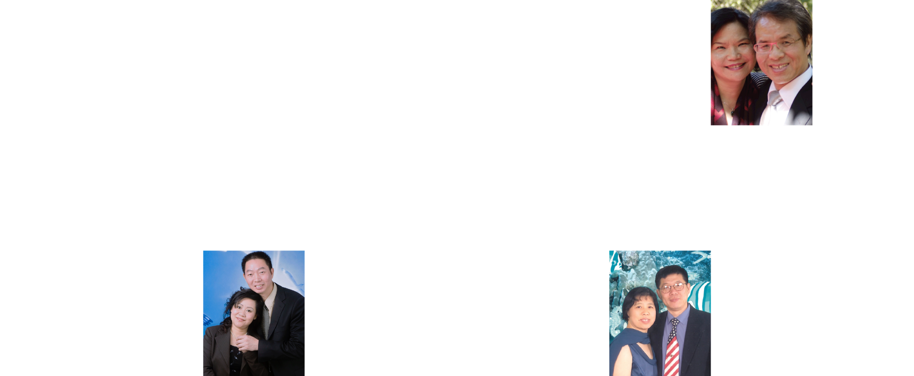









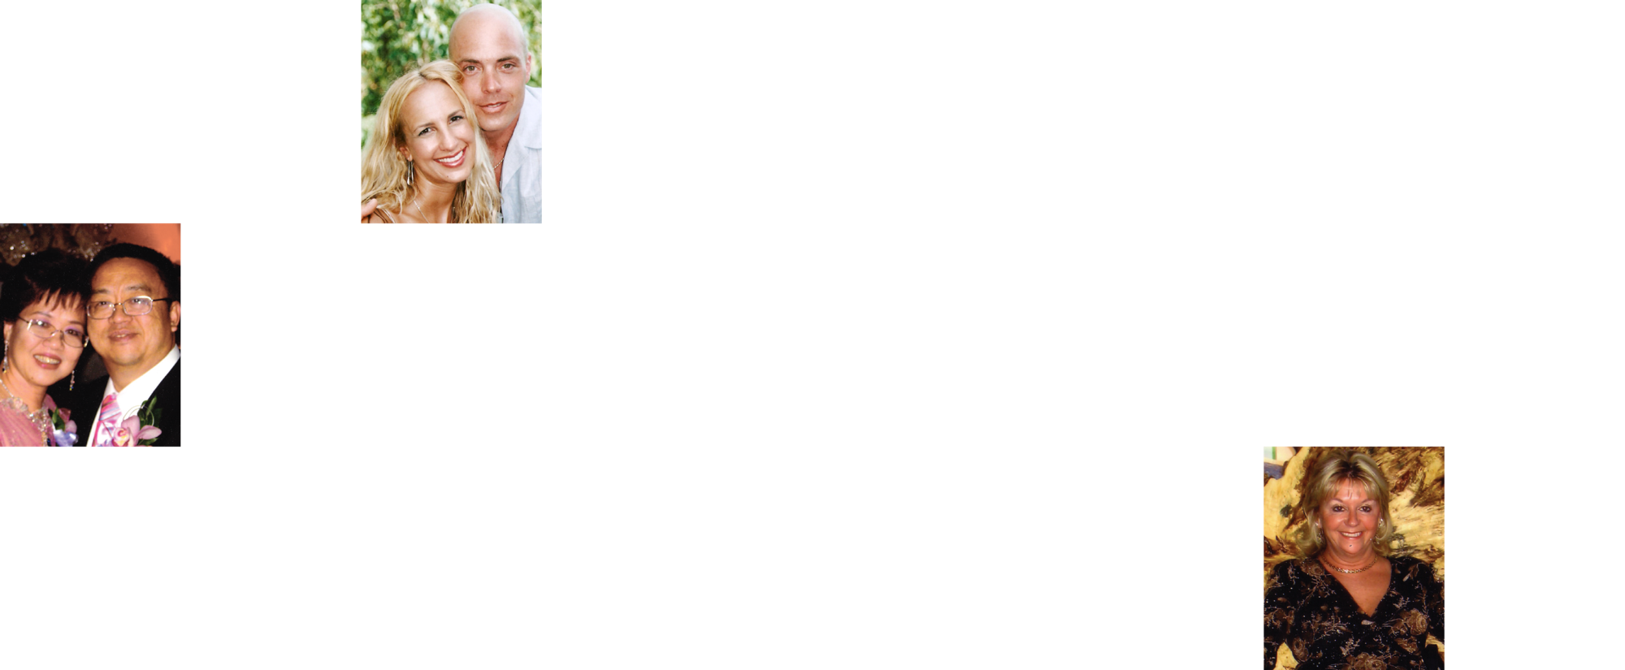
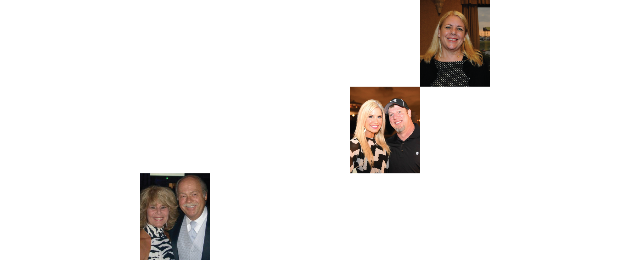
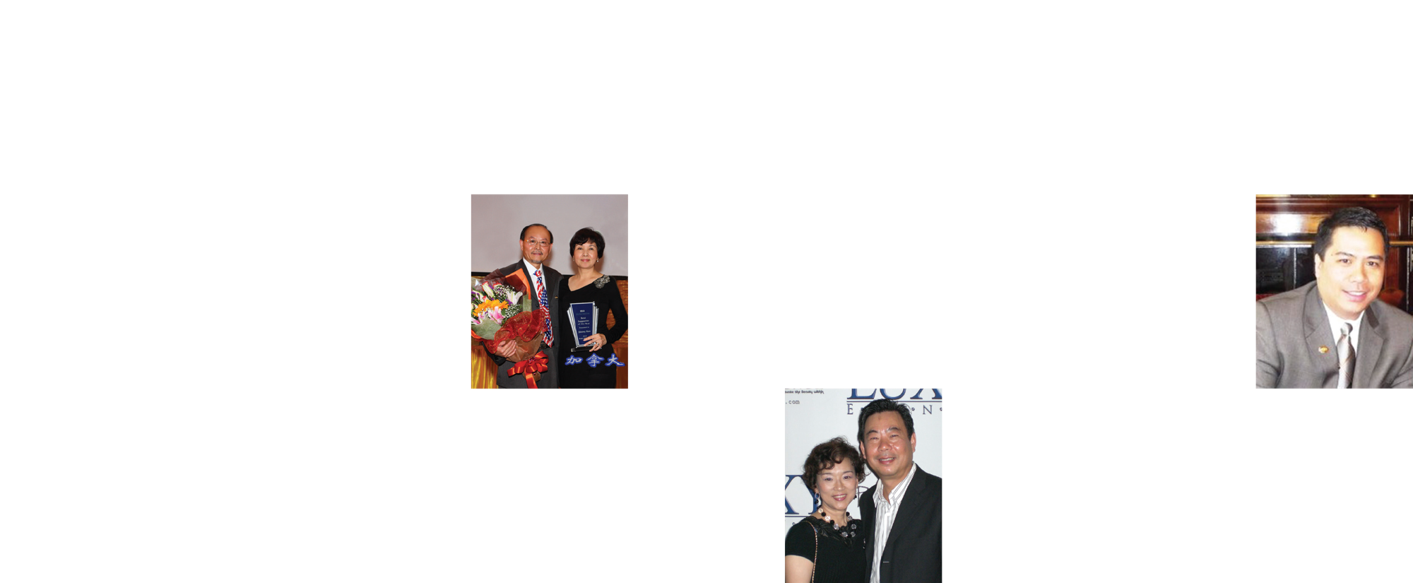
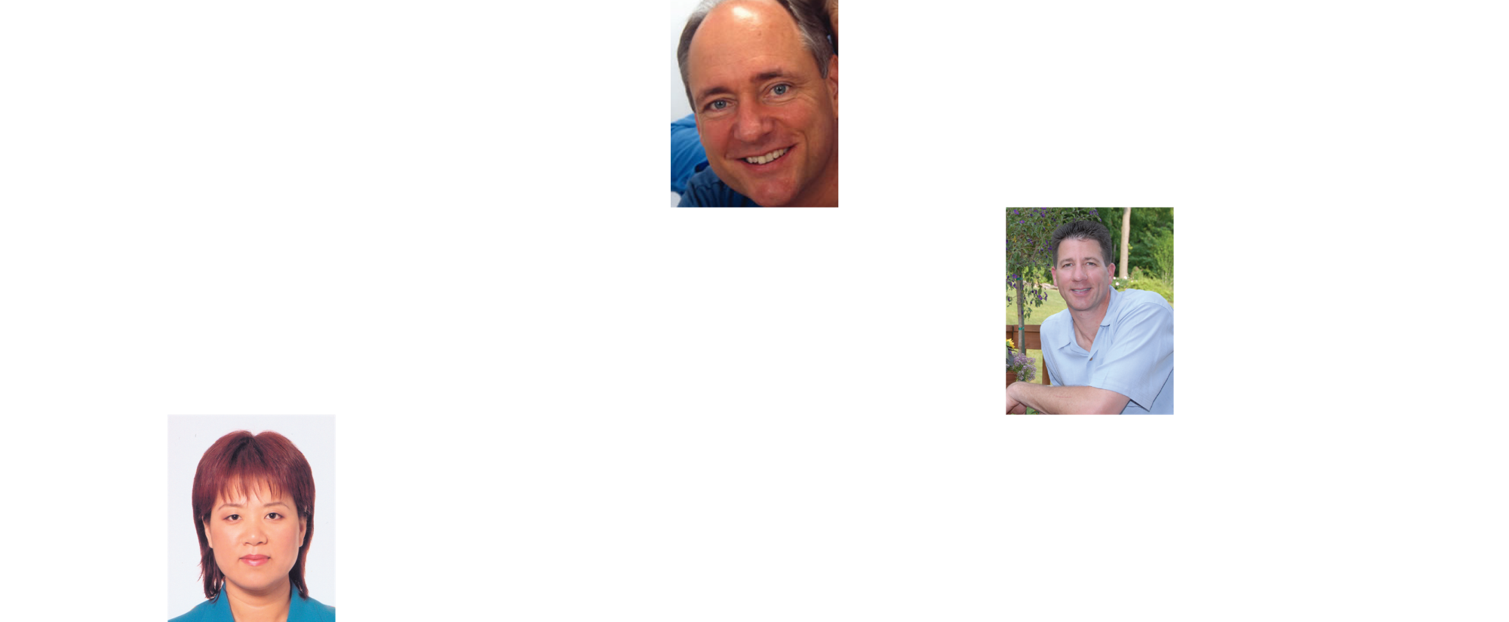





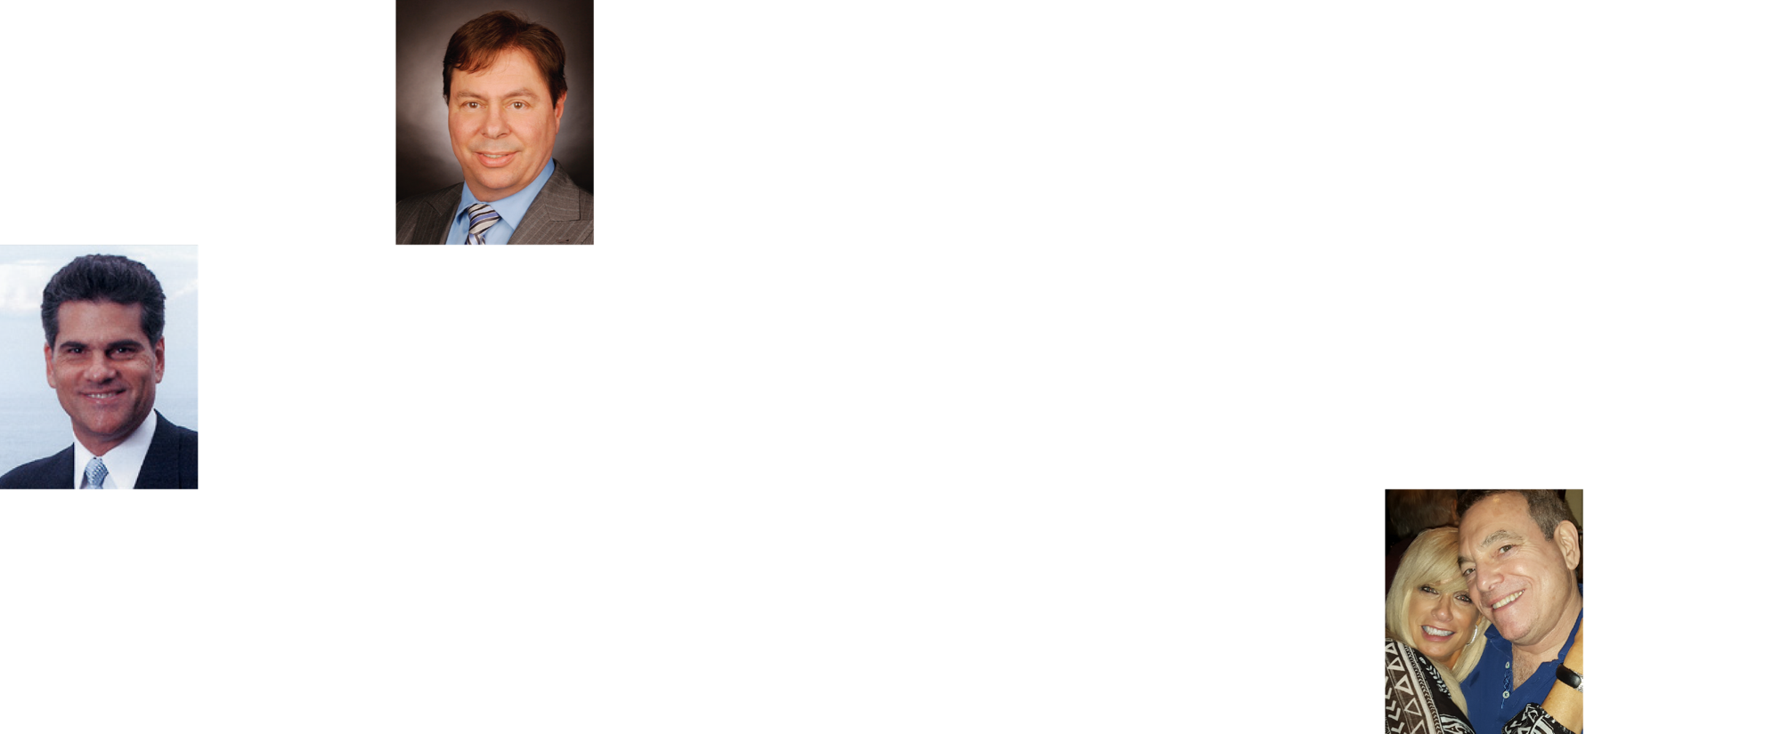

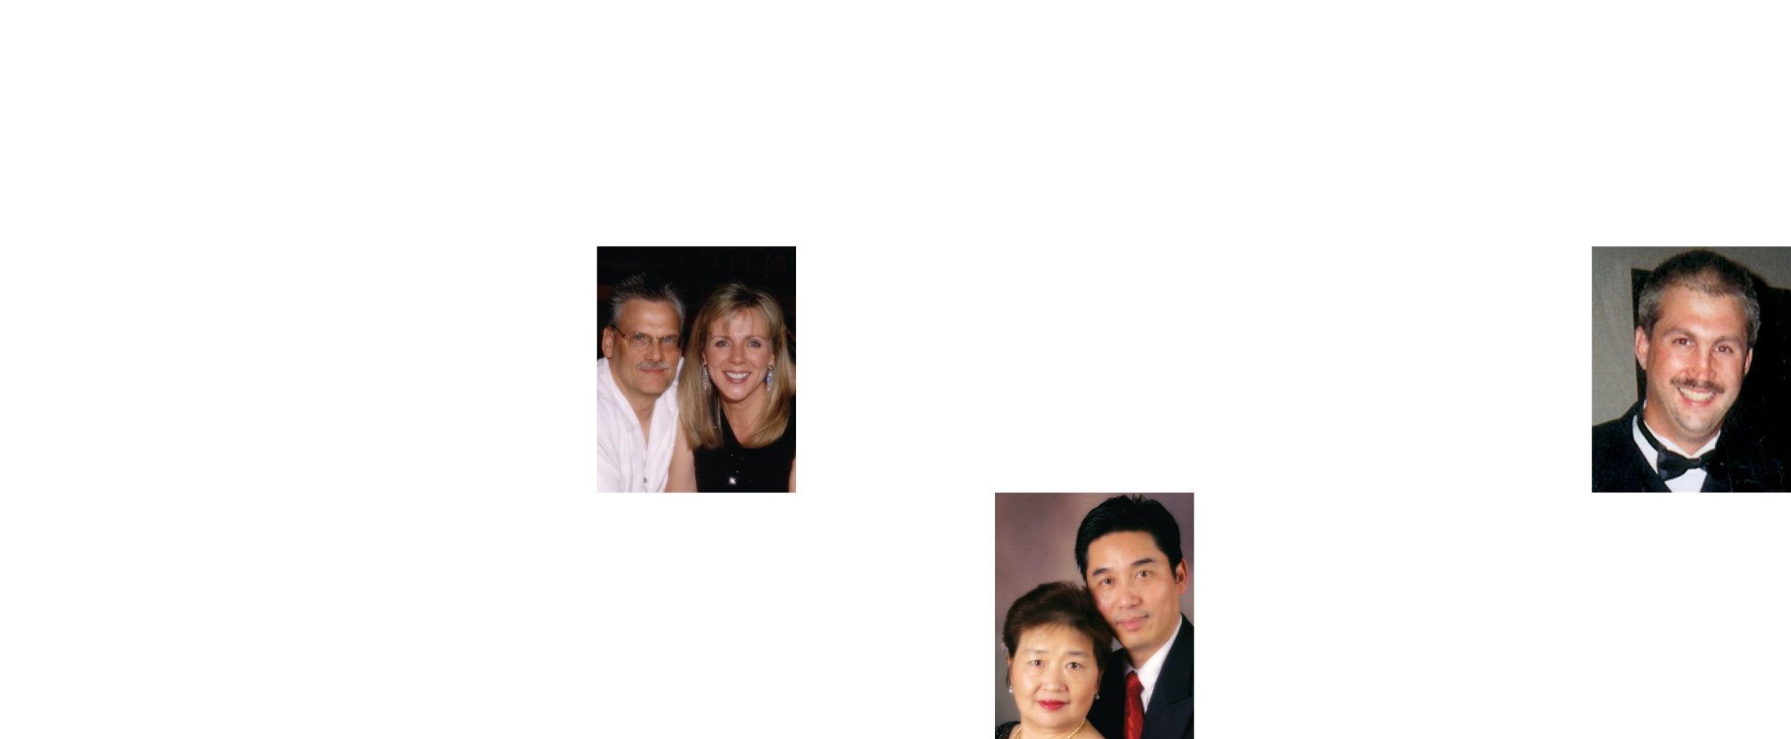




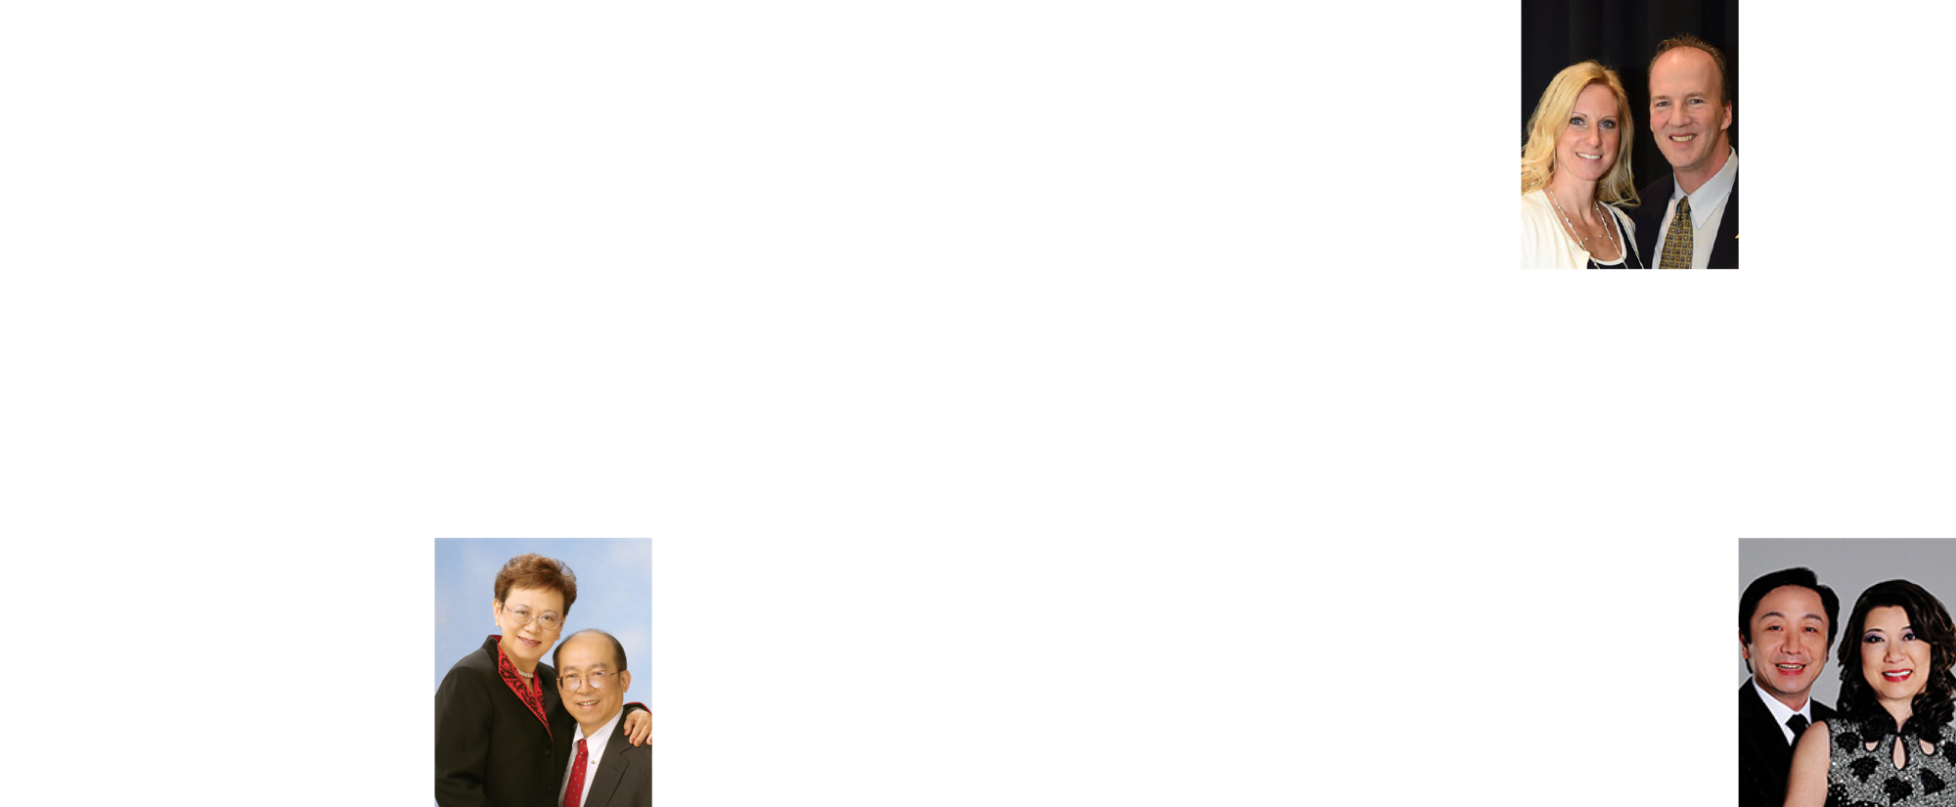




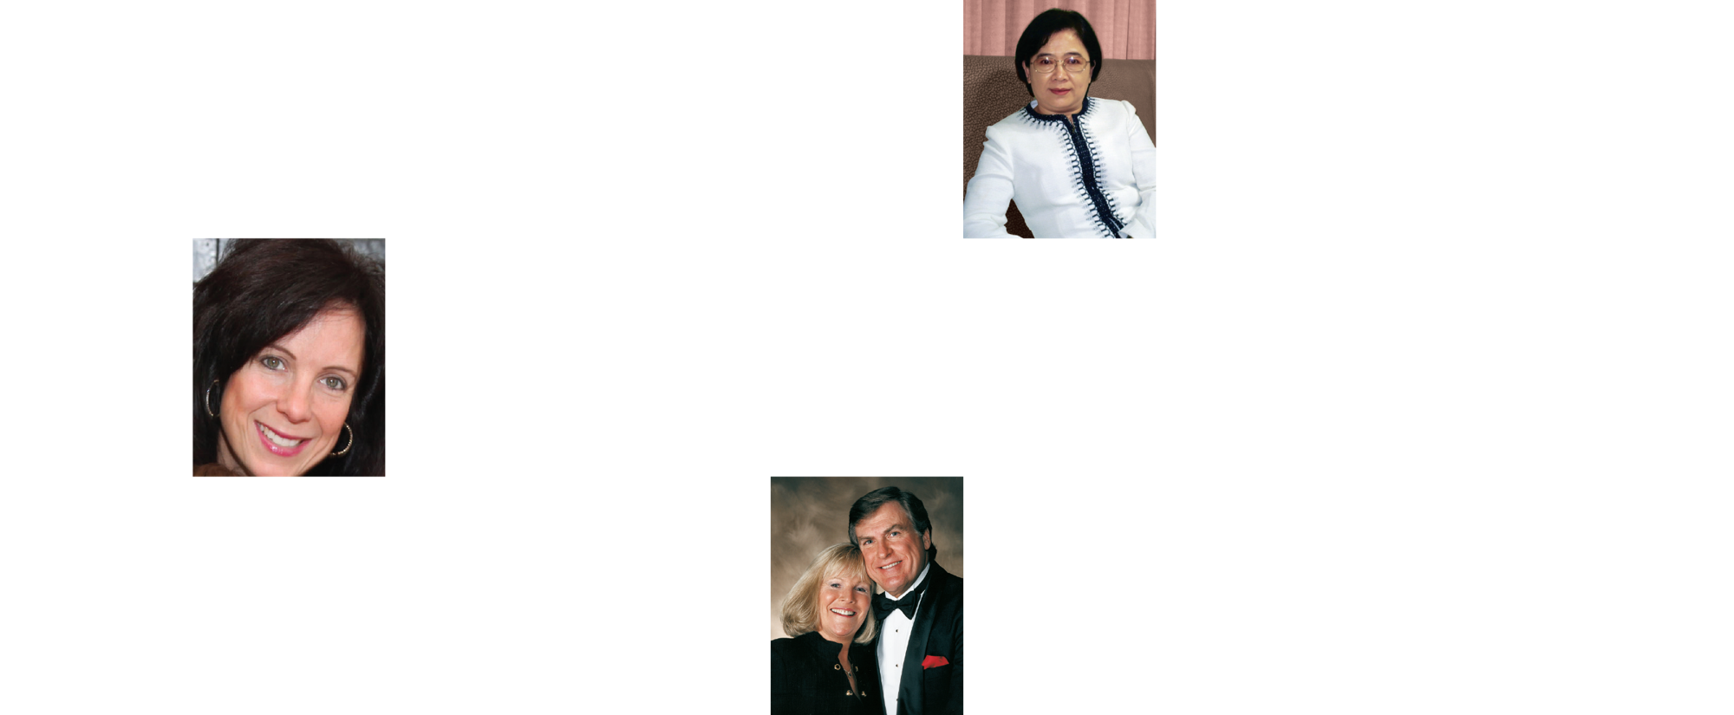



EARNED OVER ONE MILLION DOLLARS IN COMMISSIONS
MARKET AMERICA | SHOP.COM IS CHANGING THE WAY THAT PEOPLE SHOP SO EVERYONE
CAN BECOME FINANCIALLY INDEPENDENT BY CREATING THEIR OWN ECONOMY

Slide 28
More effort you’ve paid, more fortunate you’ll get
The more gratefulness, the more happiness

Slide 29
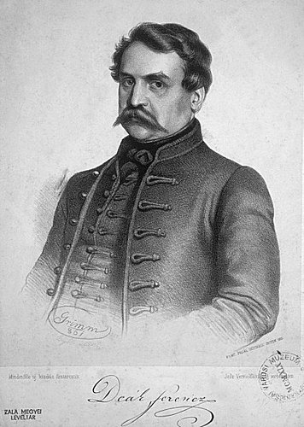
Your life is made up of an infinite amount of choices of today, not the past.——Deák Ferenc

Slide 30
2018 Market Hong Kong Annual Convention Ticket

Slide 31

Wish You Dream Come True!

